Slide 1
TO Build a VPC and launch a webserver
S.Ganesh
20a31a0394

Slide 2
Steps to create VPC
STEP 1: In the search box to the right of Services, search for and choose VPC to open the VPC console.
STEP 2:Begin creating a VPC.
STEP 3:Configure the VPC details in the VPC settings panel on the left, In the Preview panel on the right, confirm the settings you have configured.
STEP 4:Once it is complete, choose Create VPCView VPC
STEP 5:choose Subnets to view the subnet details and choose Route tables to view the route table details. The diagram below summarizes the VPC resources you have just created and how they are configured.
STEP 6:When you launch an instance, you associate one or more security groups with the instance. STEP 7:In this task, you will launch an Amazon EC2 instance into the new VPC. You will configure the instance to act as a web server.
STEP 8:Wait until Web Server 1 shows 2/2 checks passed in the Status check column.

Slide 3
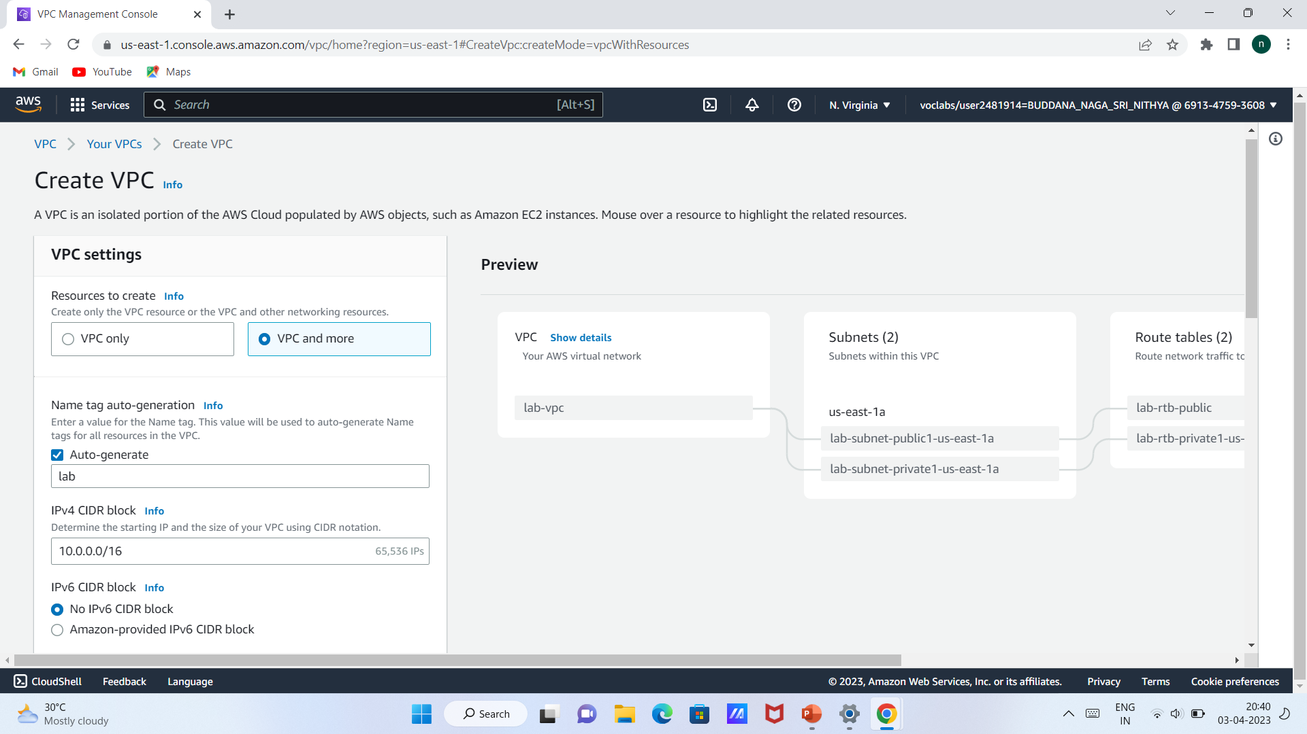

Slide 4
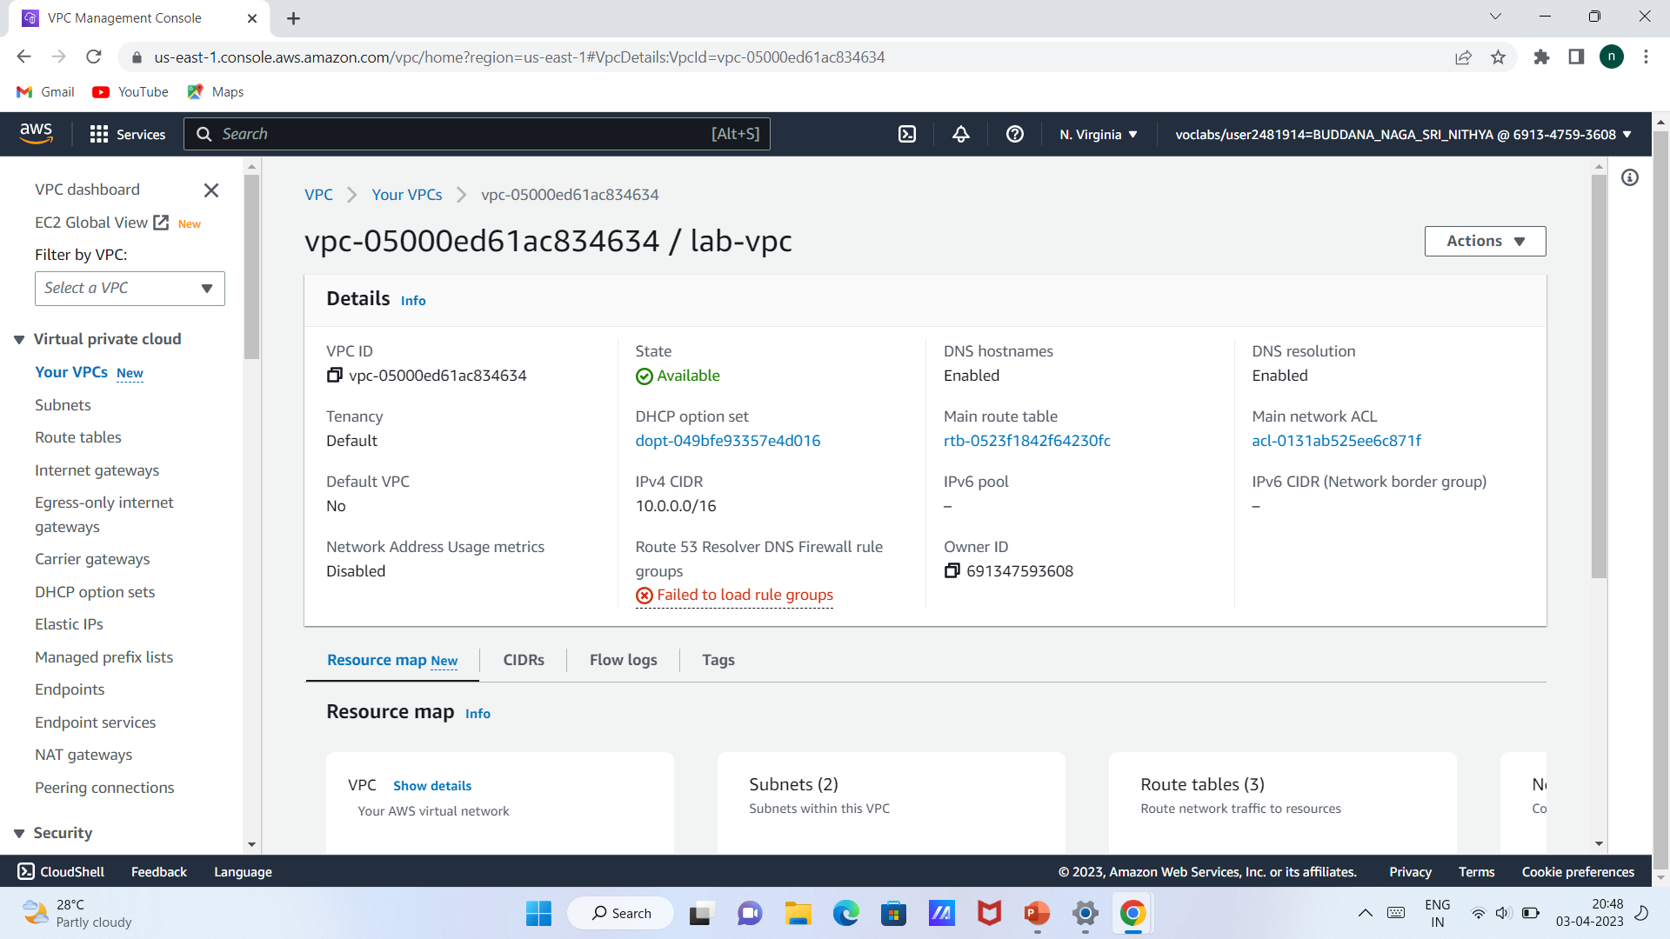

Slide 5
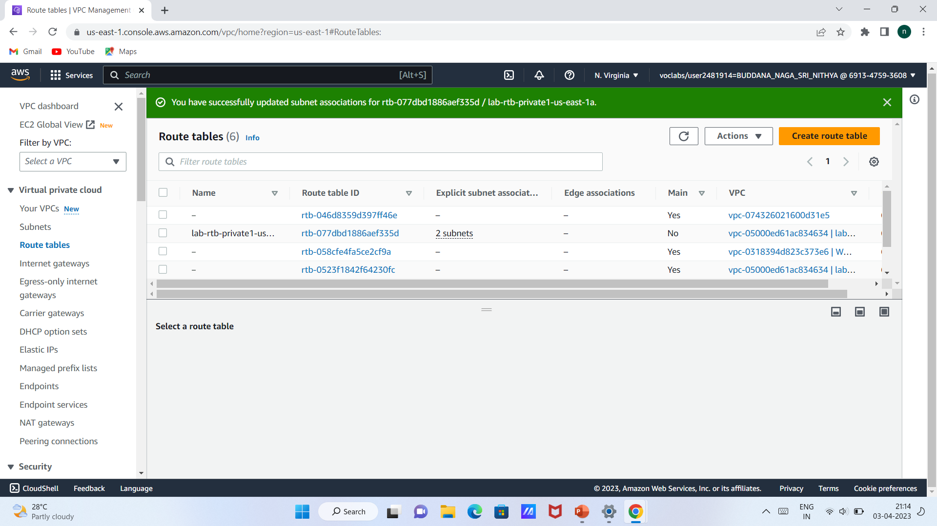

Slide 6
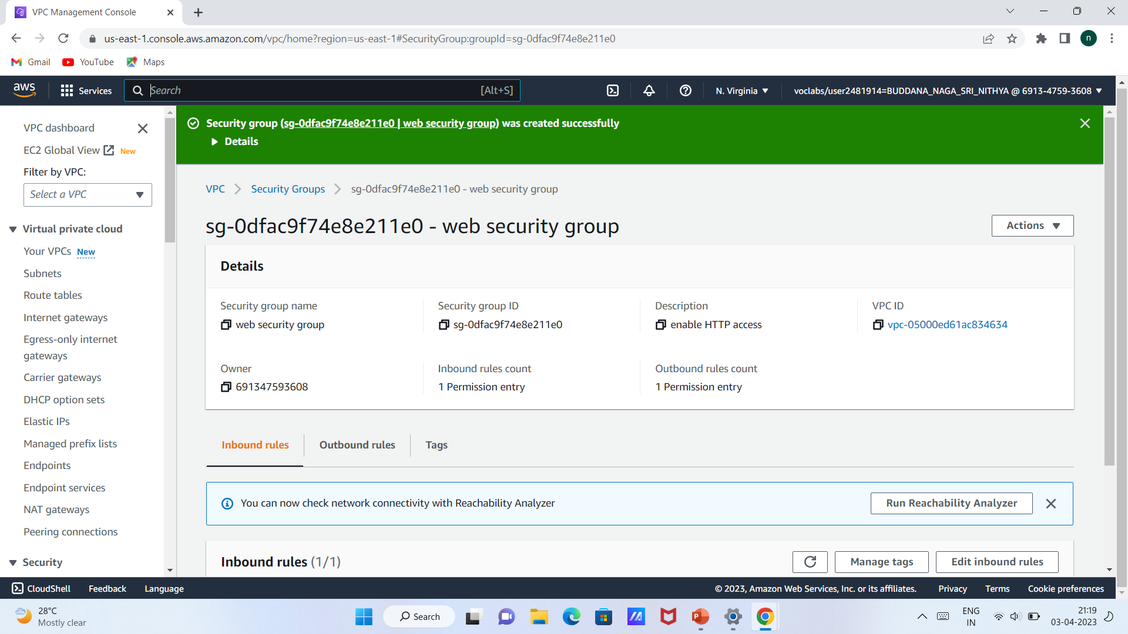

Slide 7
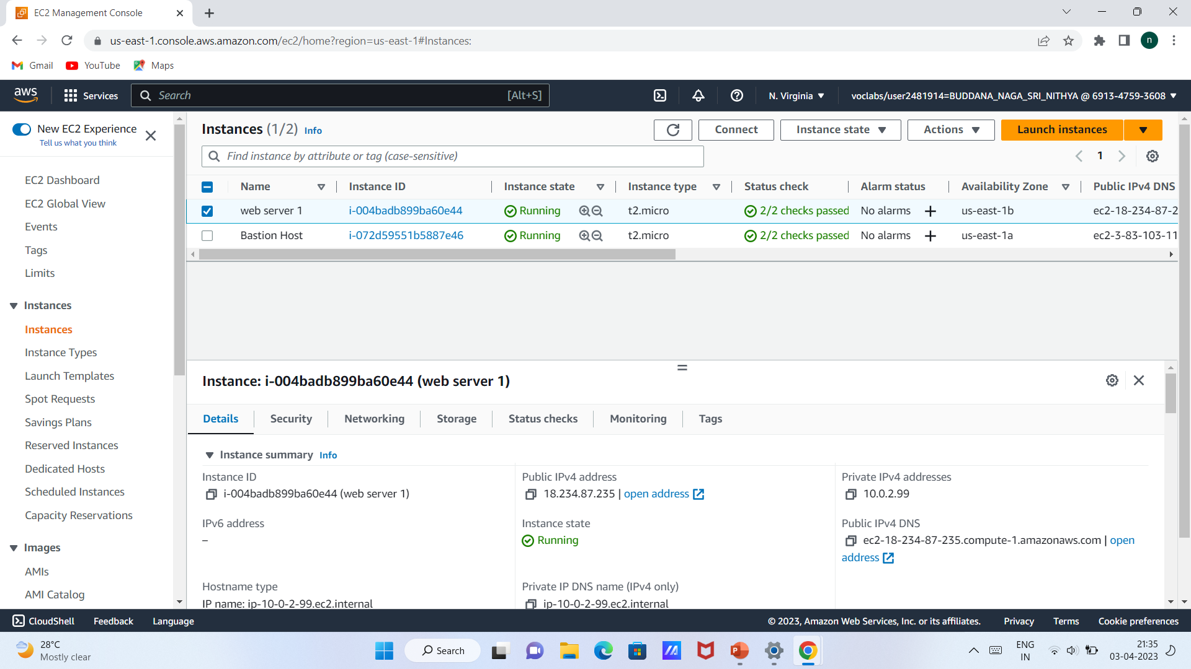

Slide 8
Create alaram by cloud watch

Slide 9
Steps to create alaram
On the Manage CloudWatch alarms detail page, under Add or edit alarm, select Create an alarm.
After creating alarm,change the currency into rupee.
For Alarm thresholds, select the metric and criteria for the alarm.
Create topic and give alarm name
Choose next and alarm is created

Slide 10
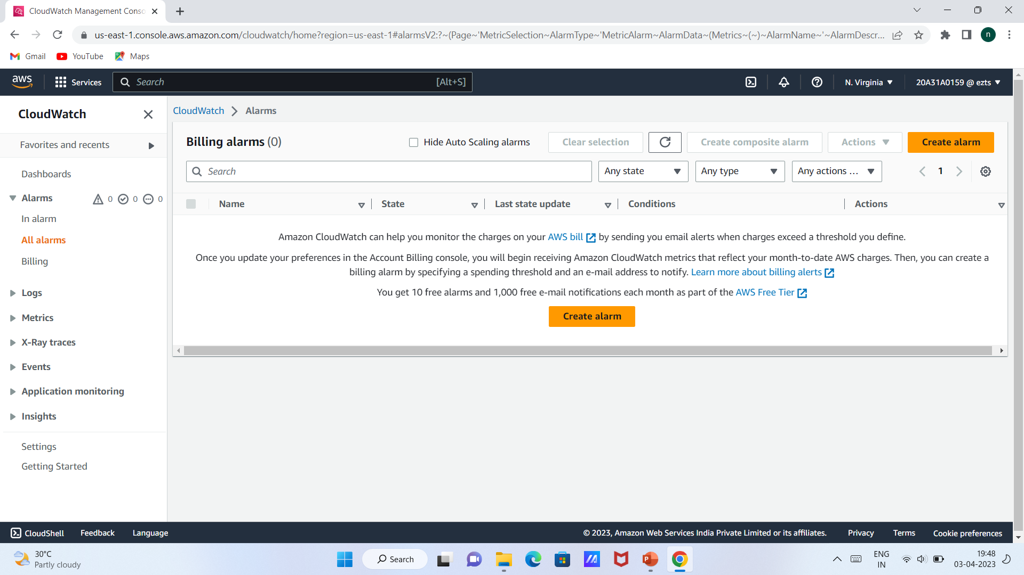

Slide 11
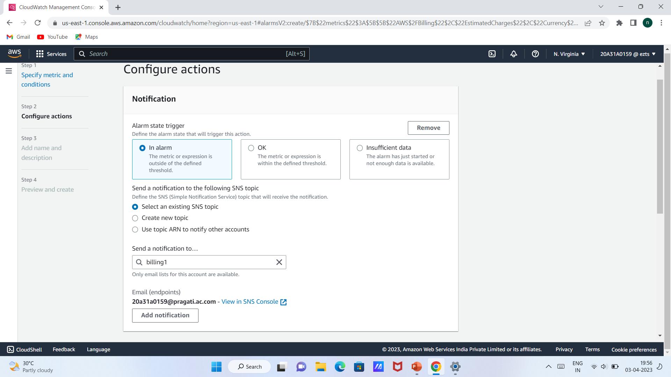

Slide 12
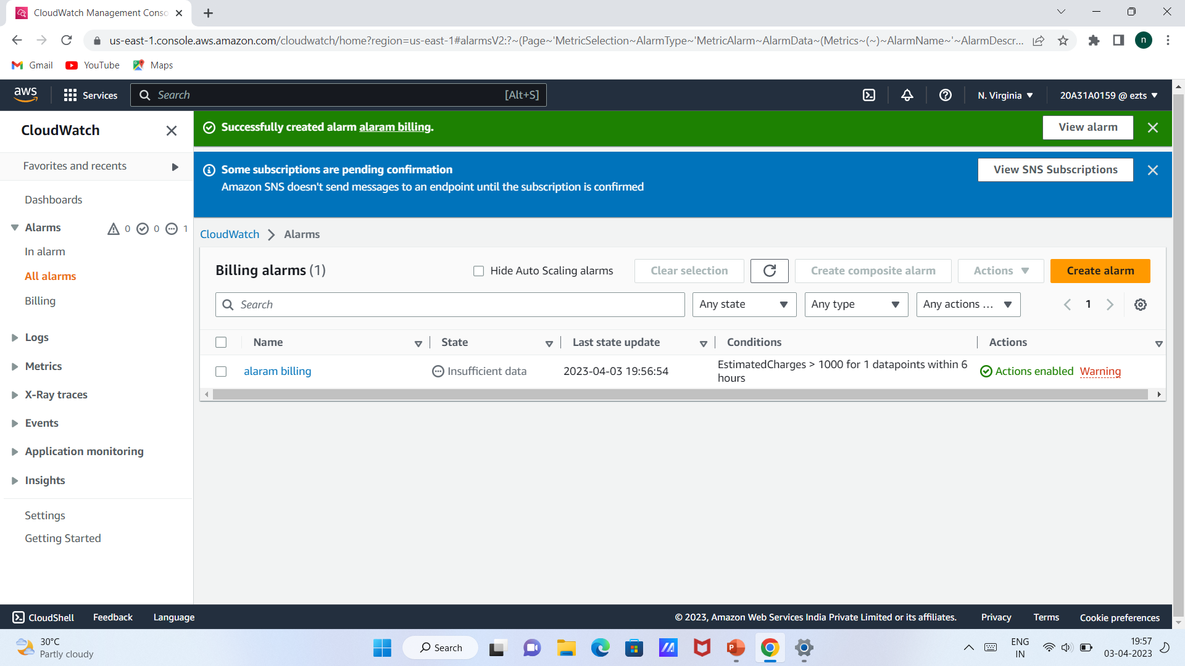

Slide 13
Creating an EC2 Instance

Slide 14
Steps to create EC2 Instance
Click on services and search for EC2 instance and select it.
Click on instance and launch then a window appears.
Give a name to the server and select window,instance type t2 micro and create a new keypair.
Pem key is download then click on launch instance
We can observe the state of instance here i.e.,running then select the instance and click connect
After that.click on RDPclient and get password.Now upload a key file we have download earlier i.e.,keypair
Click on decrypt password,the window appears as follows and save the number,public DNS and password
Paste the copied DNS name and connect.now copy and paste the username and password which we copied and click okay.
Now a window desktop appears as follows.to go back to the original desktop click X mark and then click ok.

Slide 15
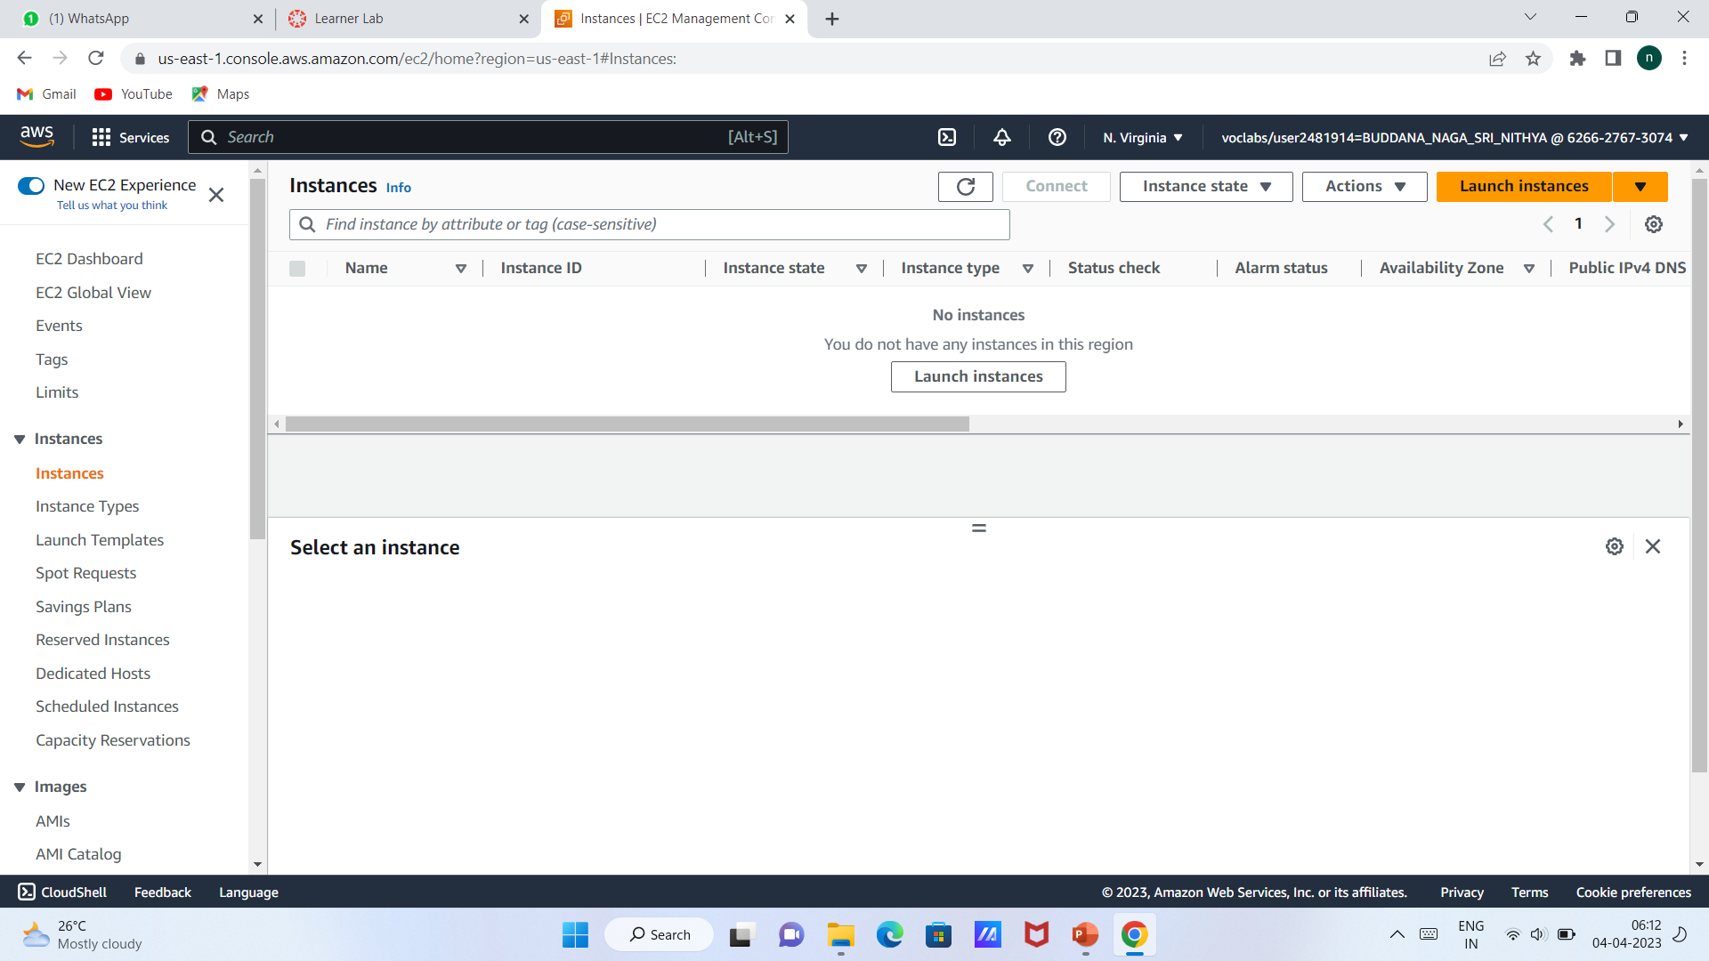

Slide 16
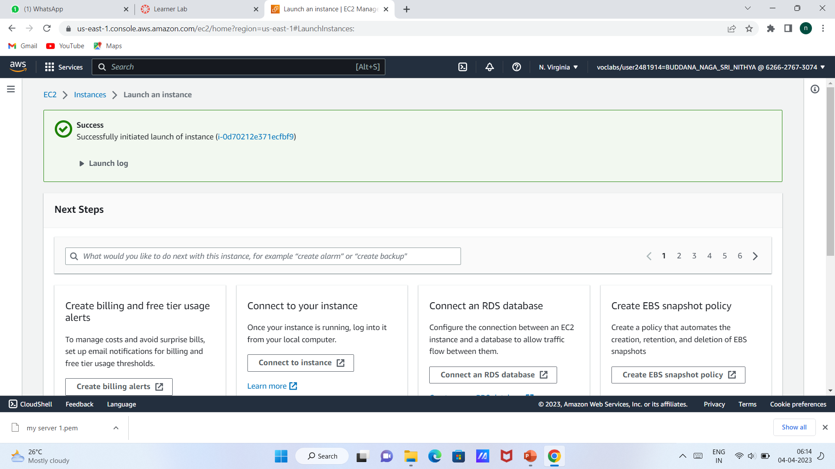

Slide 17
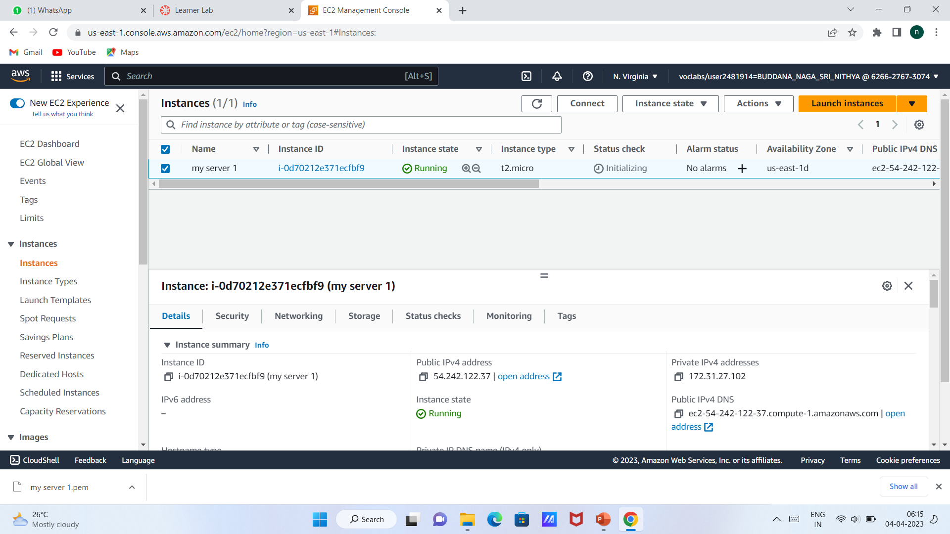

Slide 18
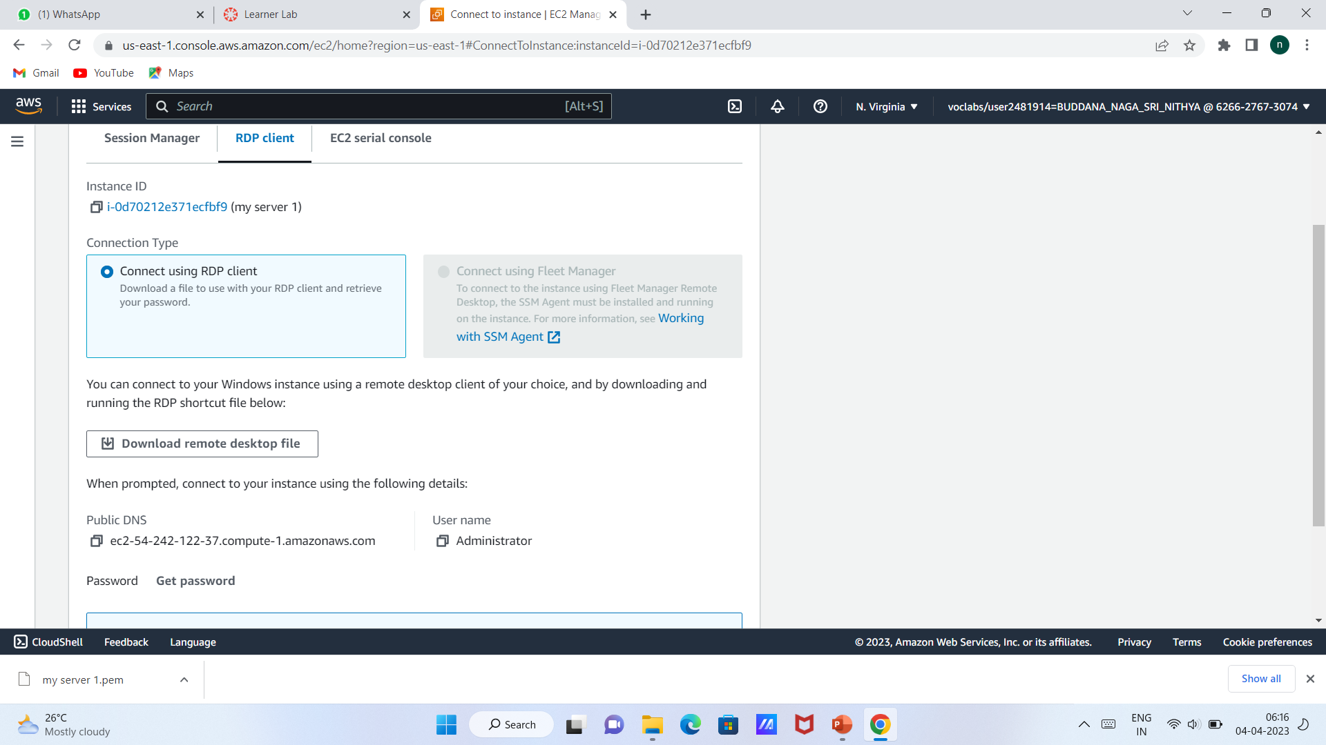

Slide 19
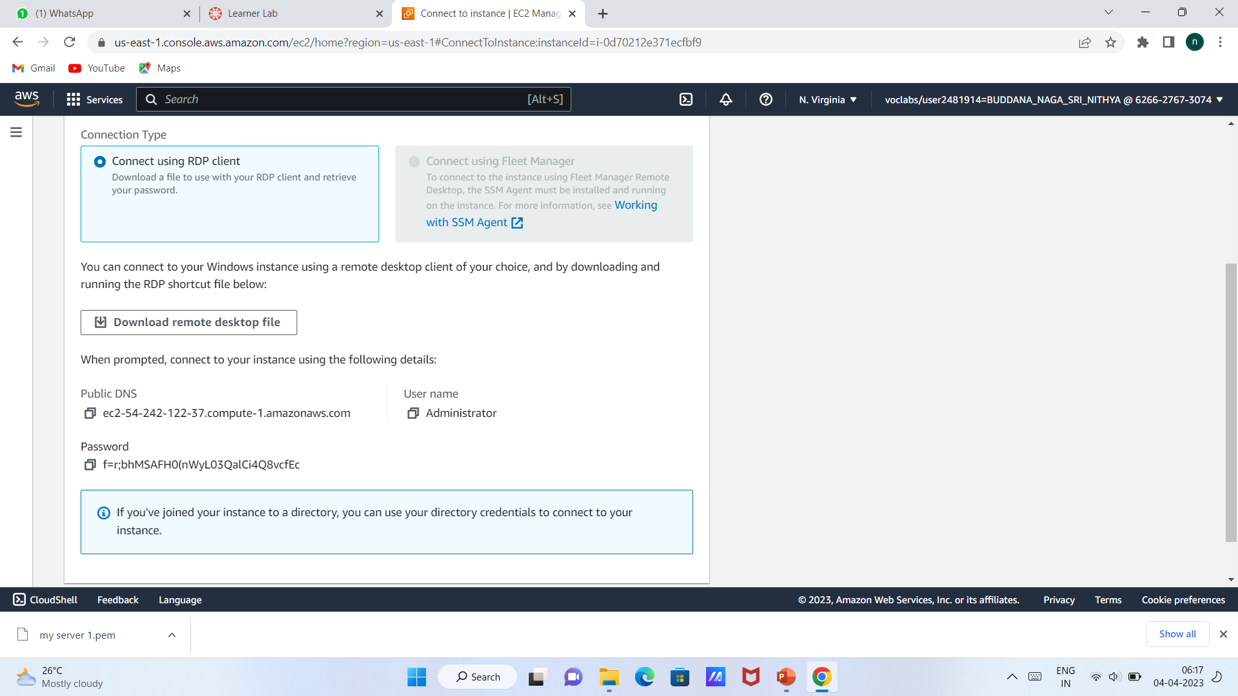

Slide 20
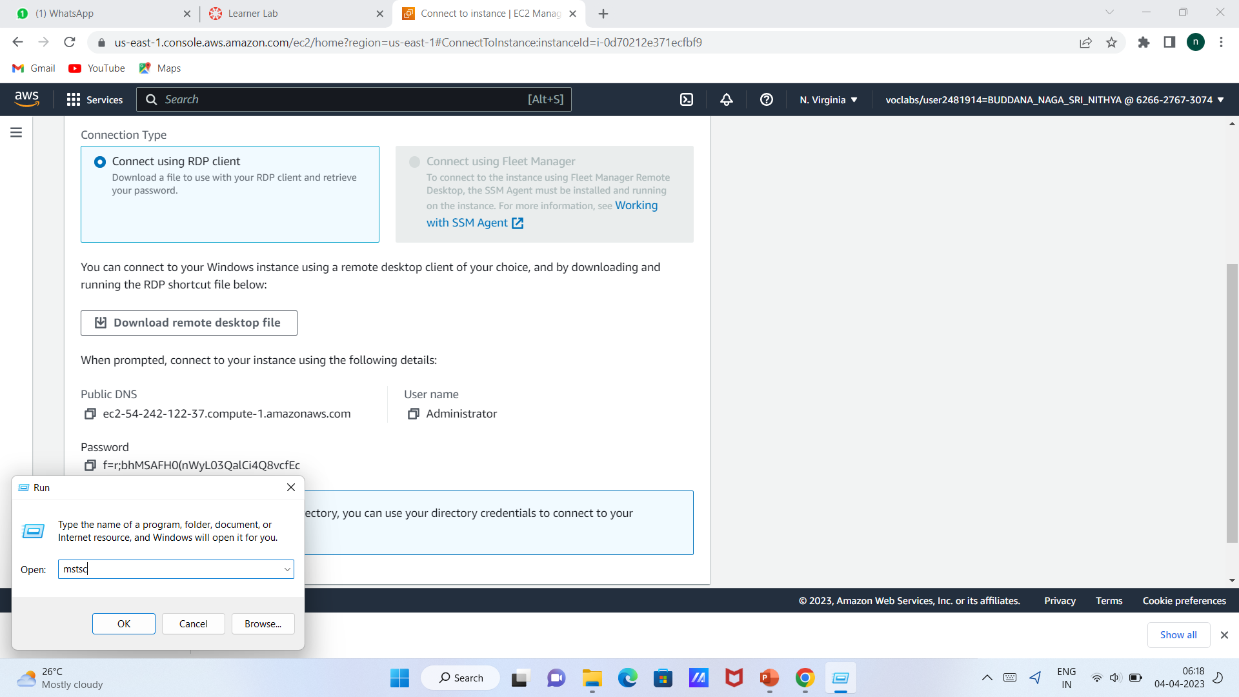

Slide 21
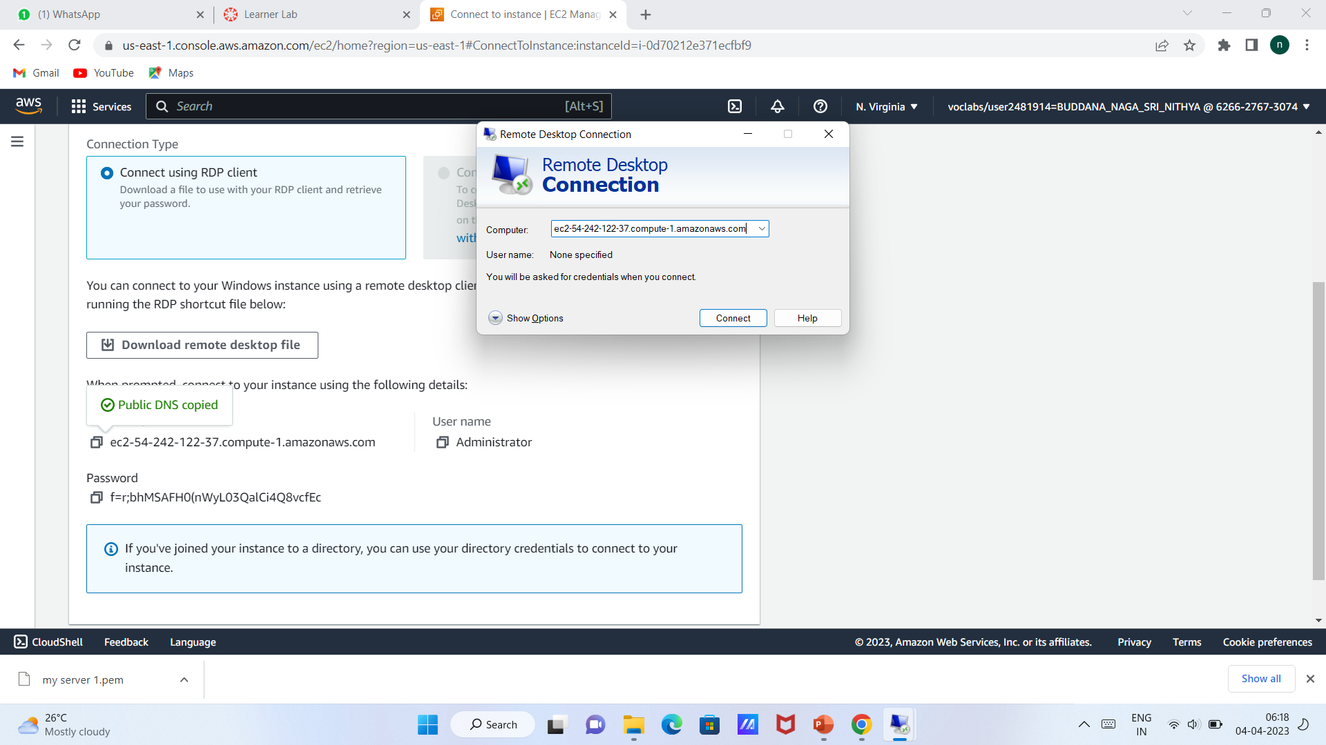

Slide 22
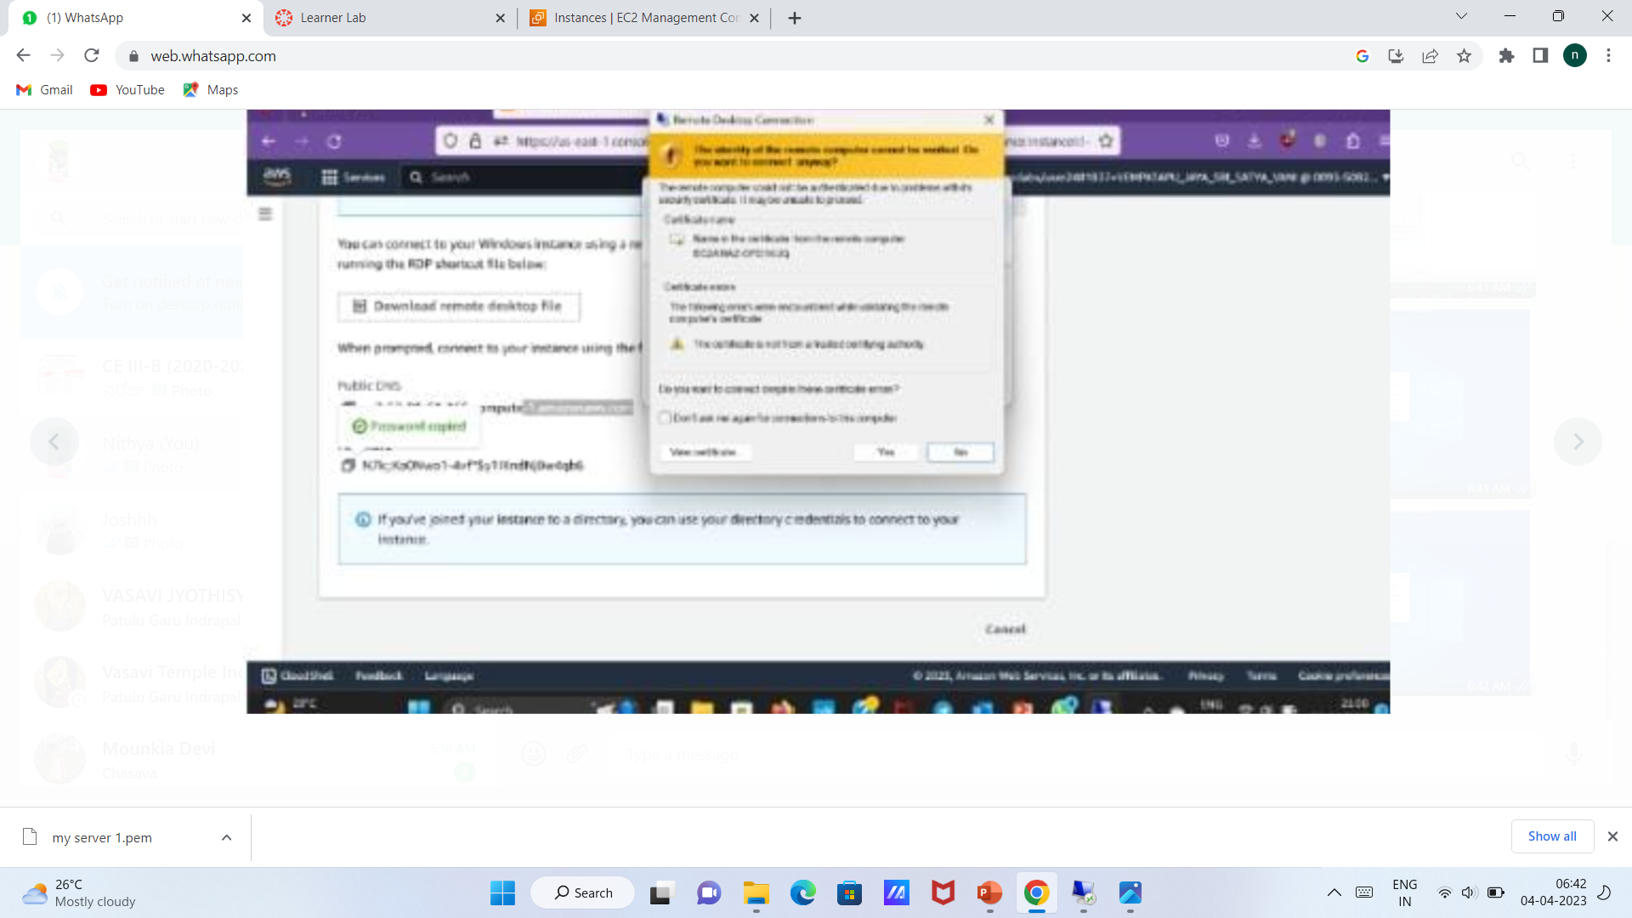

Slide 23
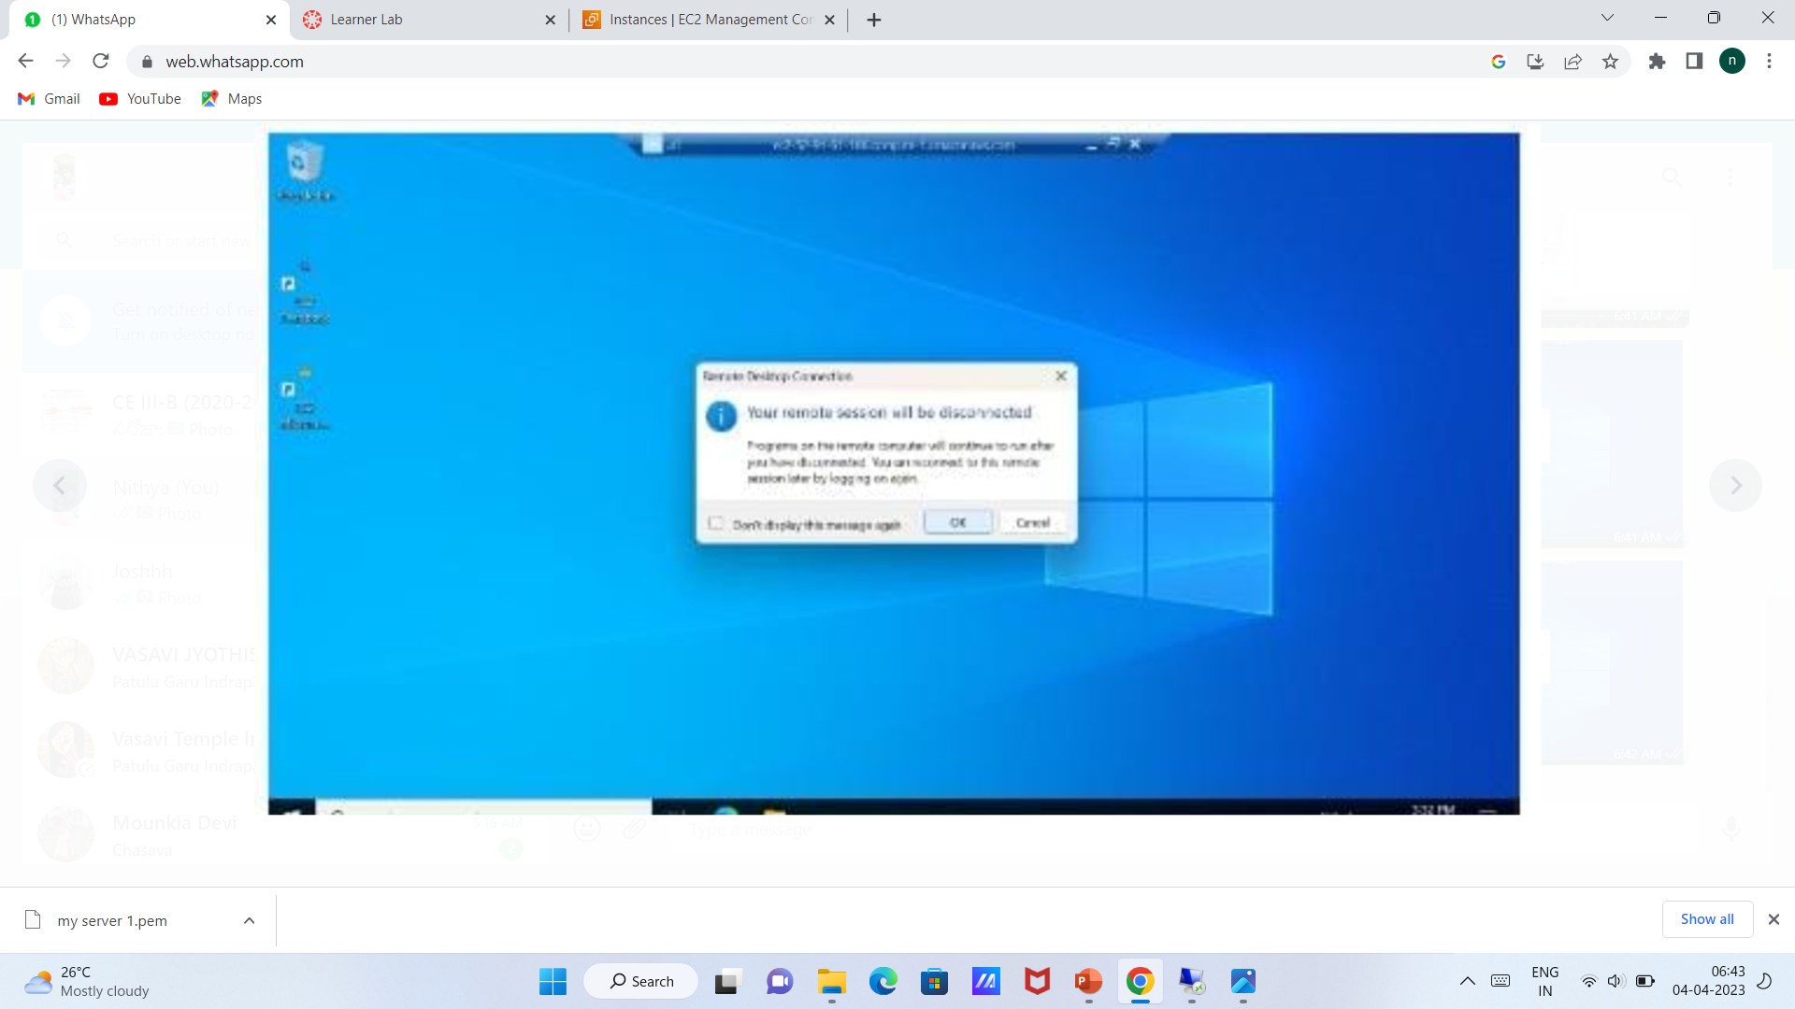

Slide 24
Click on VPC
Click on create VPC
Give the name , no.of az needed, no.of private and public subnets needed
Change the CIDR
Set the NAT gateways
Click on create VPC
View the VPC

